Slide 1
AIR QUALITY AND ACOUSTIC POLLUTION MONITORING WITH ESP32 AND SENSOR ARRAY
Project Done By
RESHMA R 2116210701212
SOWMIYA S 2116210701255

Slide 2
INTRODUCTION:
Technological advancements are increasingly focused on efficient monitoring and control to meet human needs, driven by the Internet of Things (IOT).
As a human we need fresh air to survive. Air is the most important factor in human life
The “IOT Air and Noise Monitoring System" addresses air and noise pollution in urban and industrial areas which pose significant threats to public health and overall quality of life.
Traditional methods of monitoring these pollutants are often inadequate due to their manual nature, lack of real-time data, and limited accuracy.

Slide 3
PURPOSE OF THE PROJECT:
The IoT Air and Noise Monitoring System project aims to provide real-time environmental monitoring in urban and industrial areas.
It integrates air quality and noise sensors with wireless communication, processes data through cloud or edge computing, and offers user-friendly dashboards and alerts for stakeholders.
Strategic sensor placement ensures accurate monitoring, meeting regulatory standards and raising public awareness.
Scalable and expandable, the system supports better public health, environmental management, and informed decision-making.

Slide 4
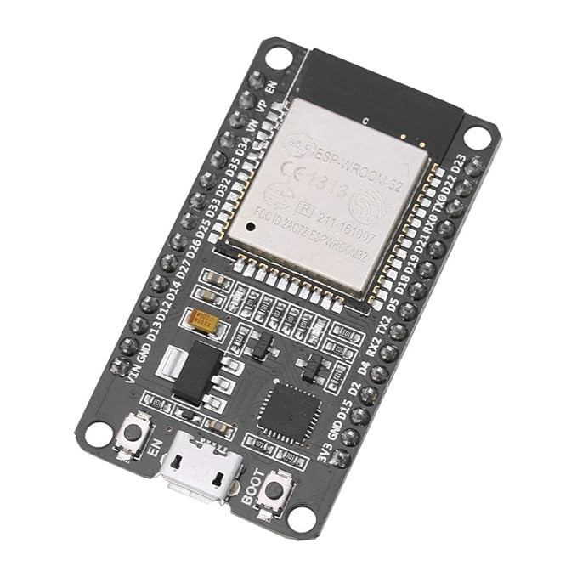
COMPONENTS USED:
ESP32 :
The ESP32 is a low-cost, dual-core microcontroller with built-in Wi-Fi and Bluetooth, ideal for IOT applications. It offers versatile connectivity and robust performance for developing smart, connected devices.

Slide 5
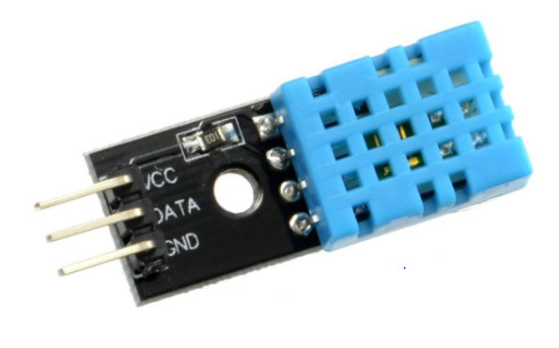
DHT11 Sensor:
The DHT11 is a basic, low-cost digital sensor used for measuring temperature and humidity. It features a capacitive humidity sensor and a thermistor, providing reliable readings with a simple interface, making it popular for DIY electronics and IOT projects.

Slide 6
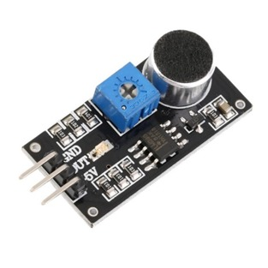
Sound Sensor – KY038:
A sound sensor is a device that converts sound waves into an electrical signal that can be processed by an electronic circuit. They can be used to detect and measure the amplitude, frequency, and duration of sound waves.

Slide 7
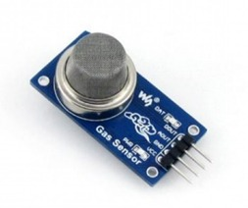
MQ135 Sensor:
The MQ135 is a gas sensor commonly used to detect pollutants like ammonia, nitrogen oxides, benzene, and carbon monoxide. It offers analog output based on the concentration of gases.

Slide 8

Arduino IDE:
The Arduino IDE (Integrated Development Environment) is used to write the computer code and upload this code to the physical board. The programming language used here is C/C++.

Slide 9
Blynk IOT:
Blynk is a platform that allows to quickly build interfaces for controlling and monitoring the hardware projects from iOS and Android devices.
Users can access the Blynk mobile app or web dashboard to view real-time sensor data, receive notifications/alerts, and remotely monitor the system.
Blynk is an IoT platform with drag-and-drop interface, library support for hardware, and cloud-based connectivity for seamless data management.

Slide 10
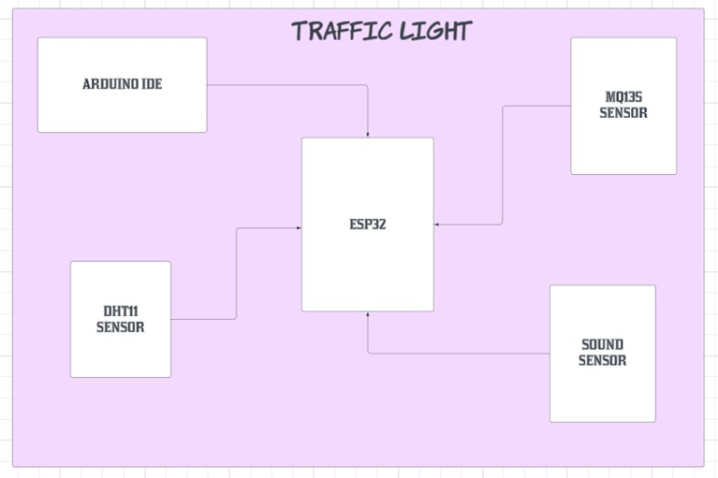
architecture diagram:

Slide 11
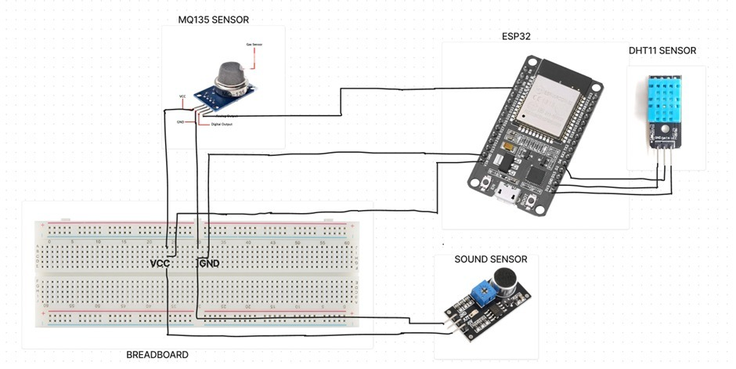
circuit diagram:

Slide 12
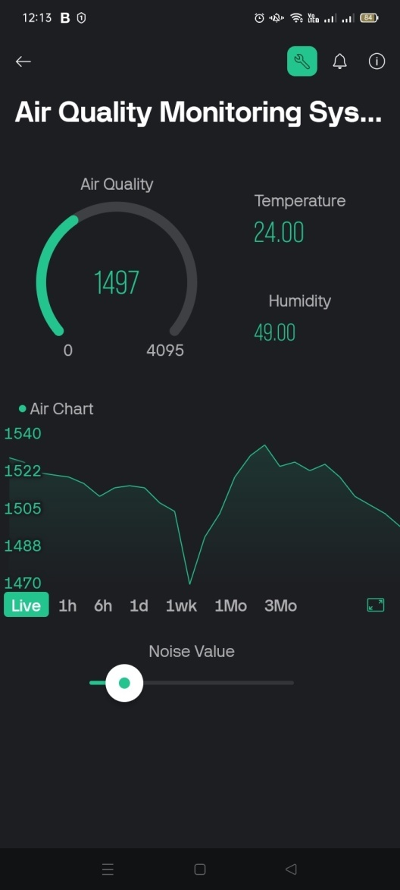
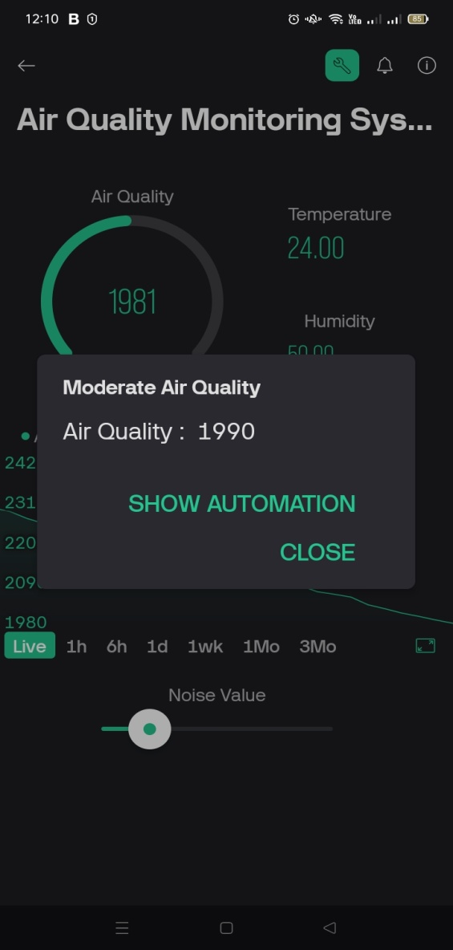
results:

Slide 13
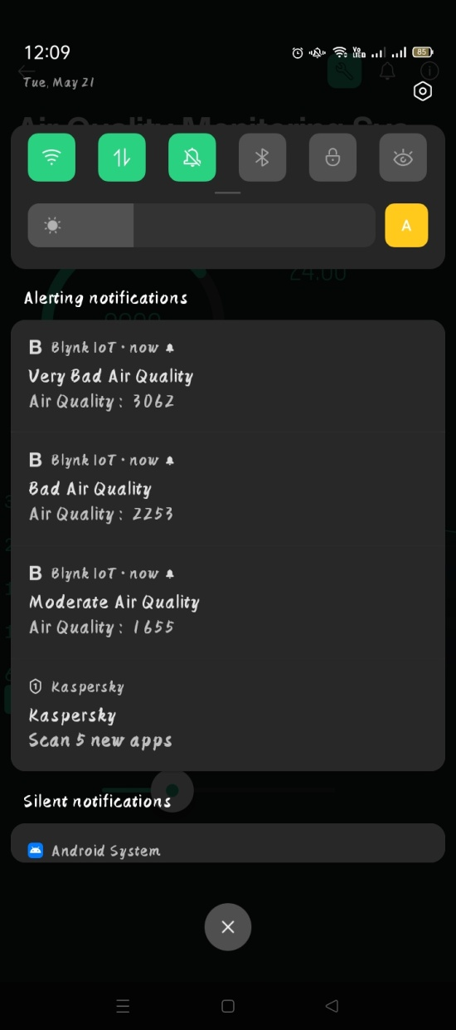
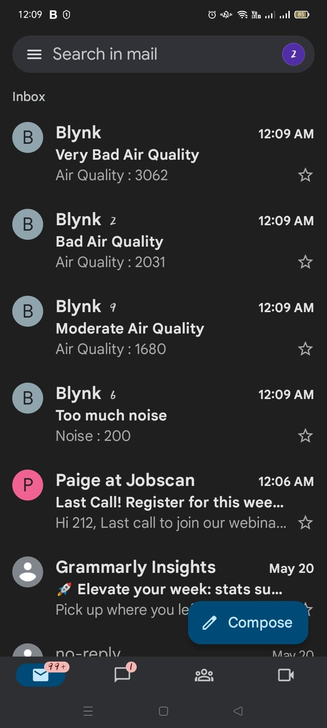
RESULTS:

Slide 14
conclusion and future enhancements:
Our system effectively observes and evaluates air quality and sound pollution in real-time through IoT integration, facilitated by the Blynk application.
Incorporating GPS trackers, could help visualize the level of pollution within specific geographical boundaries.
Machine learning algorithms can be introduced to conduct predictive analysis on historical data and other environmental parameters to predict future incidences of pollution for efficient planning in pollution mitigation.

Slide 15
THANK YOU

